Slide 1
Chapter 16 – Handling Time Series
Data Mining for Business Analytics in R
Shmueli, Bruce, Yahav, Patel & Lichtendahl

Slide 2
Main ideas
Forecast future values of a time series
Distinction between forecasting (main focus) and describing/explaining
Four components of time series:
Level
Trend
Seasonality
noise

Slide 3
Explain vrs. Predict
Explanation is the goal of “time series analysis”
Models are based on causal argument
Models are not “black-box”
Forecasting (our focus) seeks to predict future values

Slide 4
Time Series Components
Level
Trend
Seasonality
Noise

Slide 5

Amtrak Ridership (monthly)
Level - about 1,800,000 passengers per month
Appears to have U-shaped trend

Slide 6
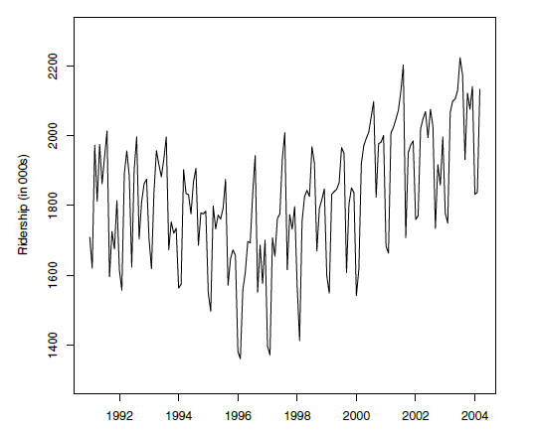
Amtrak Ridership

Slide 7
R Code for Preceding Plot
library(forecast)
Amtrak.data <- read.csv("Amtrak.csv")
# create time series object using ts()
# ts() takes three arguments: start, end, and freq.
# with monthly data, the frequency of periods per cycle is 12 (per year).
# arguments start and end are (cycle [=year], seasonal period [=month] number)
# pairs.
# here start is Jan 1991: start = c(1991, 1); end is Mar 2004: end = c(2004,
# 3).
ridership.ts <- ts(Amtrak.data$Ridership,
start = c(1991, 1), end = c(2004, 3), freq = 12)
# plot the series
plot(ridership.ts, xlab = "Time", ylab = "Ridership (in 000s)", ylim = c(1300, 2300))

Slide 8
Zoom to 3 years (1997-1999)
Seasonality* appears:
Each year traffic peaks in summer
Noise:
Departure from the general level that is neither trend nor seasonality
* Don’t confuse the time series term “season,” which is the period over which a cyclical pattern repeats (e.g. a year), with the standard English seasons of the year (fall, winter, etc.)

Slide 9
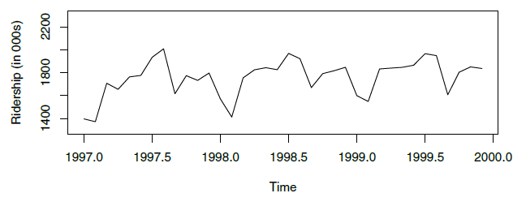
Amtrak Ridership – zoom to 3-years

Slide 10
Partitioning
Divide data into training portion and validation portion
Test model on the validation portion
Performance can be assessed against the “naïve benchmark” – naïve forecast is simply the most recent value in the time series

Slide 11
Partitioning is not random
Random partitioning would leave holes in the data, which causes problems
Forecasting methods assume regular sequential data
Instead of random selection, divide data into two parts
Train on early data
Validate on later data

Slide 12
Summary
Focus is to predict (not describe/explain)
Four components
Level
Trend
Seasonality
Noise
Partition data by dividing into early/late

